Slide 1
Linear Regression
Intuition to Machine Learning

Slide 2
Regression
Relation between input and output
Input is the independent variable: X vector
Output is the independent variable: Y vector

Slide 3
Visualise
Graph here

Slide 4
Visualise
What we saw: inputs X mapped with their corresponding outputs Y
What machine sees: inputs X with their outputs Y in a file
What we/machines have to do ?: Form a relation between the inputs and outputs so that we can get predictions for future outputs.

Slide 5
Hypothesis
The main task of the machine will be to predict the output
How to represent that relation ?

Slide 6
Hypothesis
Graph here

Slide 7
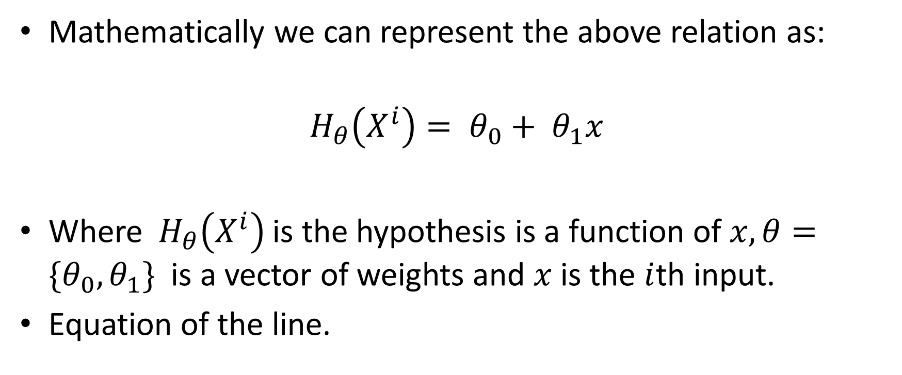
Hypothesis
Mathematically we can represent the above relation as:
$$H_{θ}\left(X^{i}\right)= θ_{0}+ θ_{1}x$$
Where${ H}_{θ}\left(X^{i}\right)$ is the hypothesis is a function of $x, θ={\{θ}_{0},θ_{1}\}$ is a vector of weights and $x$ is the $i$th input.
Equation of the line.

Slide 8
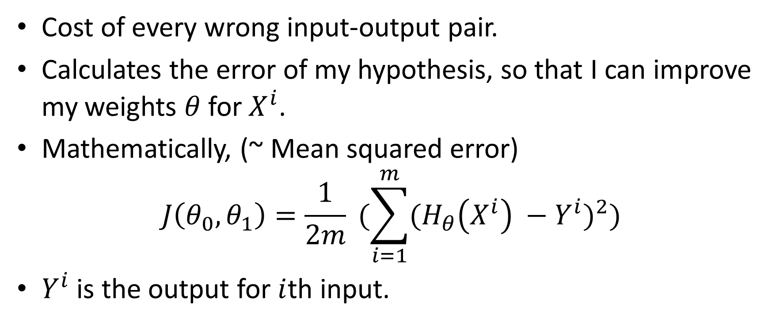
Cost Function
Cost of every wrong input-output pair.
Calculates the error of my hypothesis, so that I can improve my weights $θ$ for $X^{i}$.
Mathematically, (~ Mean squared error)
$$J\left(θ_{0},θ_{1}\right)=\frac{1}{2m} (\sum_{i=1}^{m}{{(H_{θ}\left(X^{i}\right) −Y^{i})}^{2}})$$
$Y^{i}$ is the output for $i$th input.

Slide 9
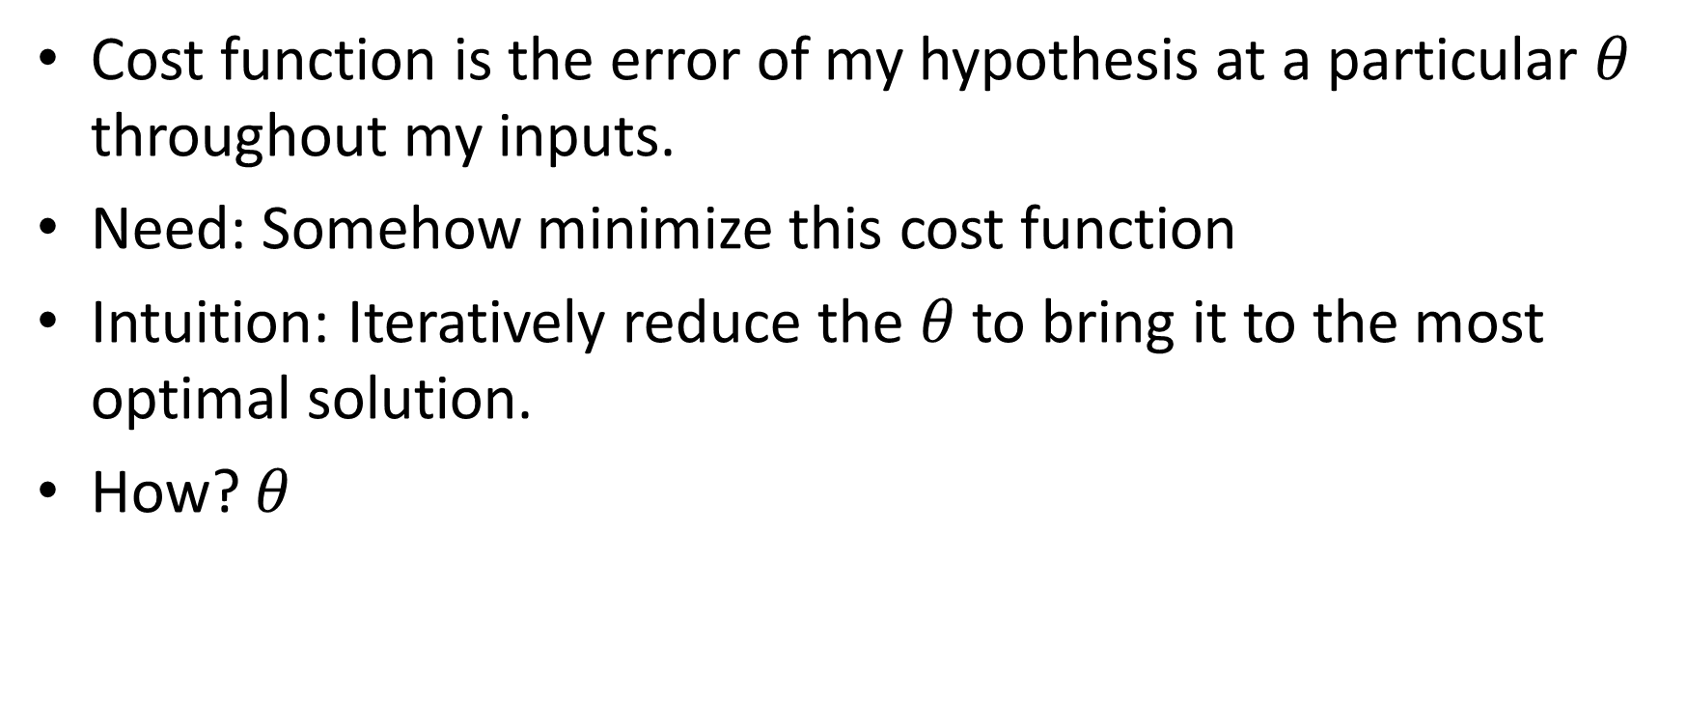
Cost Function
Cost function is the error of my hypothesis at a particular $θ$ throughout my inputs.
Need: Somehow minimize this cost function
Intuition: Iteratively reduce the $θ$ to bring it to the most optimal solution.
How? $θ$

Slide 10
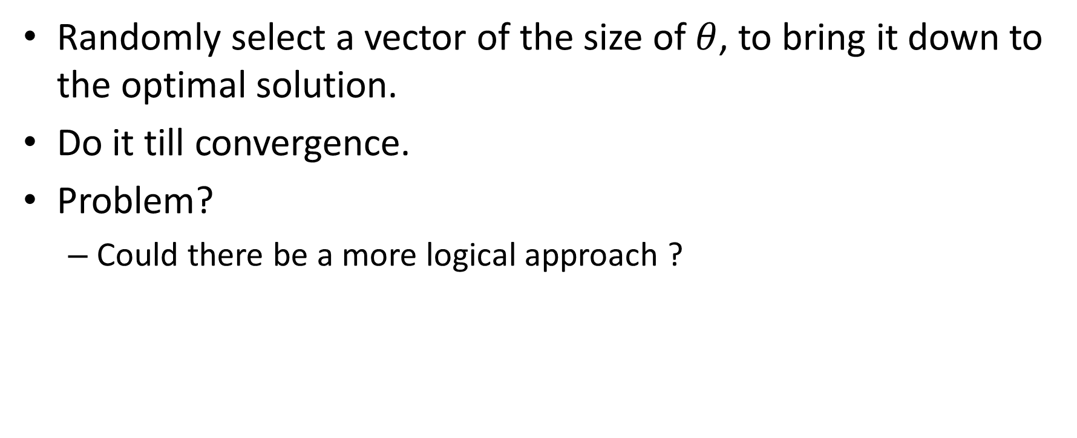
Random Iterative Descent
Randomly select a vector of the size of $θ$, to bring it down to the optimal solution.
Do it till convergence.
Problem?
Could there be a more logical approach ?

Slide 11

Numerical Descent
Use the partial derivative of each of $θ$.
Derivative = slope, and we just need to get to slope = 0.
Gradient Descent.

Slide 12
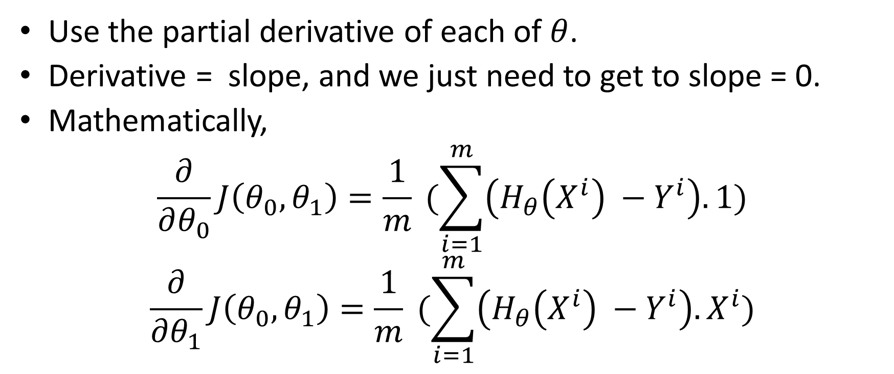
Numerical Descent
Use the partial derivative of each of $θ$.
Derivative = slope, and we just need to get to slope = 0.
Mathematically,
$$\frac{∂}{∂θ_{0}}J\left(θ_{0},θ_{1}\right)=\frac{1}{m} (\sum_{i=1}^{m}{\left(H_{θ}\left(X^{i}\right) −Y^{i}\right).1})$$
$$\frac{∂}{∂θ_{1}}J\left(θ_{0},θ_{1}\right)=\frac{1}{m} (\sum_{i=1}^{m}{\left(H_{θ}\left(X^{i}\right) −Y^{i}\right).X^{i}})$$

Slide 13

Gradient Descent
$$repeat till convergence\{$$
$$θ_{j}=θ_{j} − α\frac{∂}{∂θ_{j}}J\left(θ_{0},θ_{1}\right)$$
$$\}$$
$α$ = step-size / Learning Rate

Slide 14
Visualize
Contour Plot here.

Slide 15
Assignment
Computationally implement all the functions:
Hypothesis
Cost function
Gradient Descent

